Slide 1
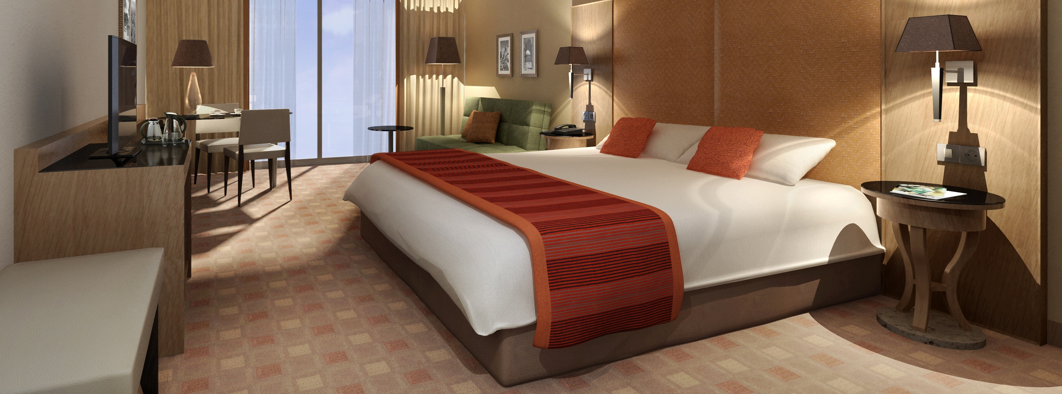
HOTEL REVENUE ANALYSIS

Slide 2
PROBLEM
Hotels face challenges in data-driven decision-making due to fragmented information across systems.
This fragmentation leads to poor visibility into metrics like occupancy and rate performance.
As a result, pricing optimization and revenue maximization are negatively affected.
An integrated analytical solution is needed to consolidate data.
Such a solution would provide actionable insights through interactive dashboards.
This would support strategic revenue decisions.

Slide 3

Module 1: Data Modeling & Ingestion
Transform raw hotel booking data into a reliable, analytics-ready foundation.
Power strategic decision-making across the organization.
Project Objective:
Build a scalable, enterprise-grade data model.
Convert fragmented booking information into actionable business intelligence.
Enable faster queries.
Ensure consistent reporting across all departments.
Booking Transactions
Reservation records, payment history, and booking channels
Customer Profiles
Guest demographics, preferences, and loyalty status
Room Inventory
Room types, amenities, and availability data
Hotel Branch Information
Location details, capacity, and property attributes

Slide 4
Data Model (Star Schema)
A star schema organises data with a central fact table linked to dimension tables, enabling faster queries, simpler analysis, and scalable reporting.
DimCustomer
Customer ID
Name
Gender
Loyalty Tier
Country
DimRoom
Room ID (PK)
Room Type
Bed Count
Price per Night
Amenities
FactBookings
Booking ID (PK)
Room ID (FK)
Customer ID (FK)
Branch ID (FK)
Date ID (FK)
Revenue
Duration of Stay
DimDate
Date ID (PK)
Full Date
Day
Month
Year
Weekday / Weekend
DimBranch
Branch ID (PK)
Branch Name
Location
Star Rating
Manager Name

Slide 5
Business Rules & Derived Fields
1
2
3
Stay Duration Calculation
Formula: Stay Duration = Check-out Date − Check-in Date
Automatically computed for every booking to enable downstream analytics and customer segmentation.
Stay Type Formula
Day Use: 1 day (business travellers, hourly bookings)
Short Stay: ≤ 3 days (weekend getaways)
Extended Stay: 4–7 days (vacation travellers)
Long Stay: ≥ 8 days (corporate relocations, extended trips)
Room Category Logic
Standard: ≤ 3 days capacity (economy segment)
Deluxe: ≤ 6 days capacity (mid-tier comfort)
Premium: ≤ 10 days capacity (luxury experience)
Suite: > 10 days capacity (executive-level accommodations)

Slide 6
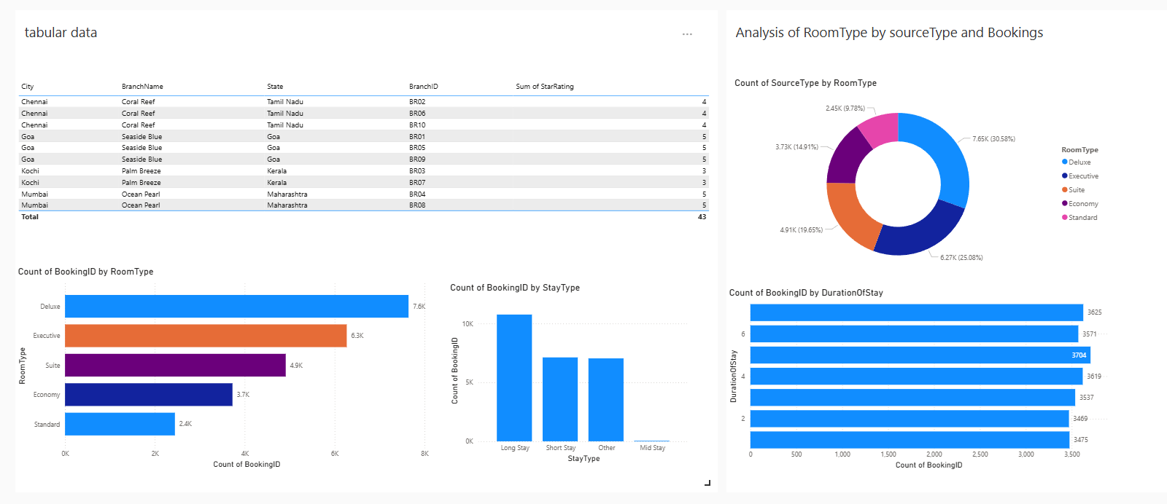
Module 1: Data Modeling and Ingestion

Slide 7

MODULE 2 - OCCUPANCY & REVENUE METRICS
KEY PERFORMANCE INDICATORS (KPIS) :
Occupancy % = (Rooms Sold ÷ Rooms Available) × 100
ADR (Average Daily Rate ) = Total Room Revenue ÷ Rooms Sold
01
02
Shows how many hotel rooms are occupied out of total available rooms.
➡ Helps measure room utilization efficiency.
Average revenue earned per sold room.
➡ Indicates pricing strength.
03
RevPAR (Revenue per Available Room) = ADR × Occupancy %
Combines Occupancy % and ADR to show overall revenue efficiency.
➡ Most important hotel performance metric.

Slide 8
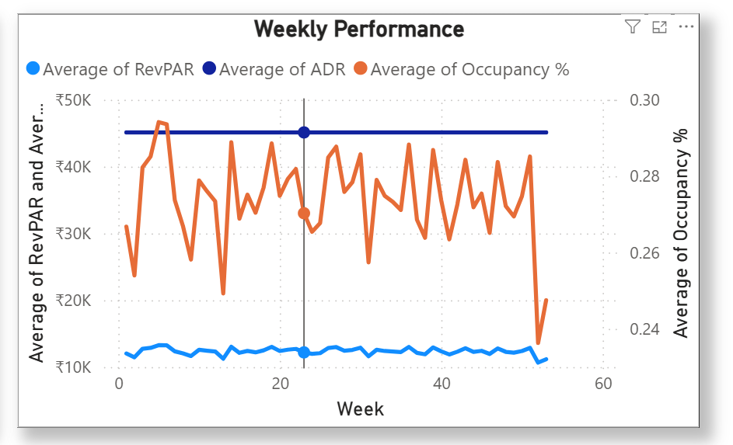
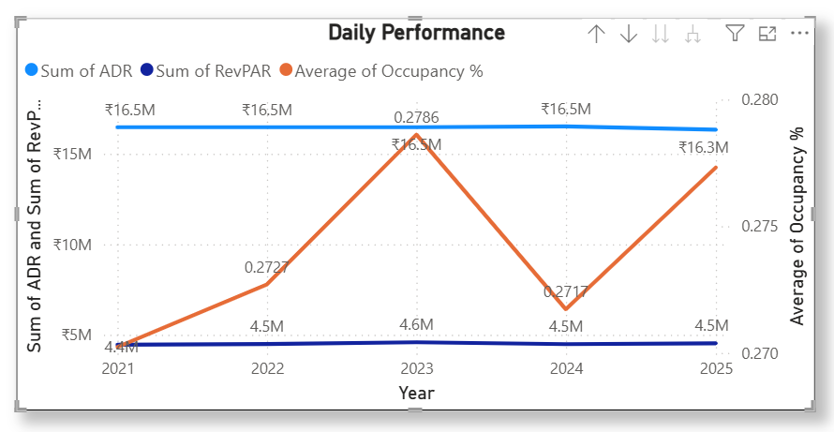
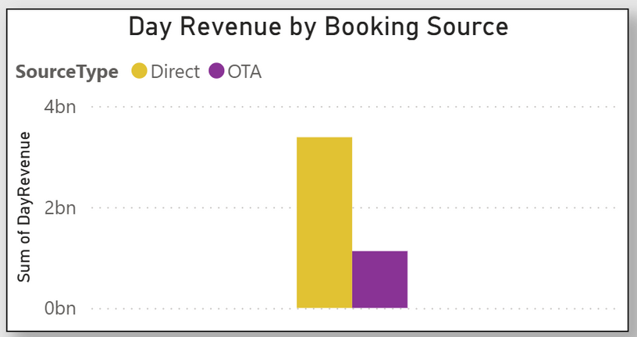
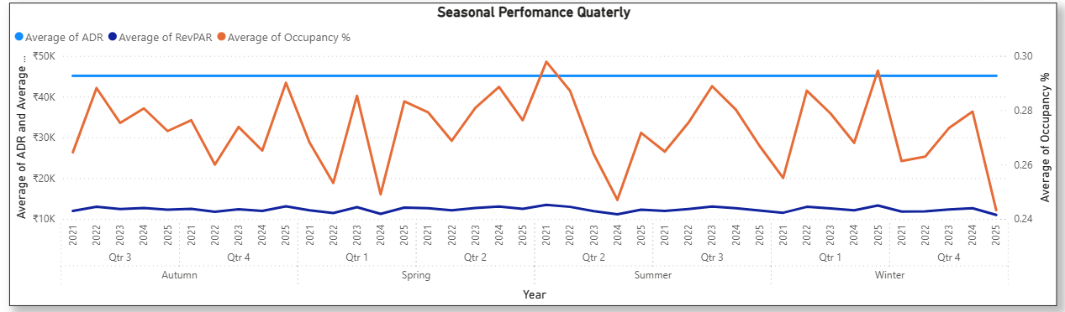
Module 2: Occupancy & Revenue Metrics

Slide 9
MODULE 3: GUEST ANALYSIS
Guest Segmentation
01
02
Customer Clustering
03
Demographic Analysis
04
Guest Value Metrics
Key Insights:
High spenders contribute the highest revenue.
Loyal guests show frequent repeat bookings.
Couples and families are the dominant guest types.
India, UK, and USA are top source markets.
Digital payments are most preferred.

Slide 10
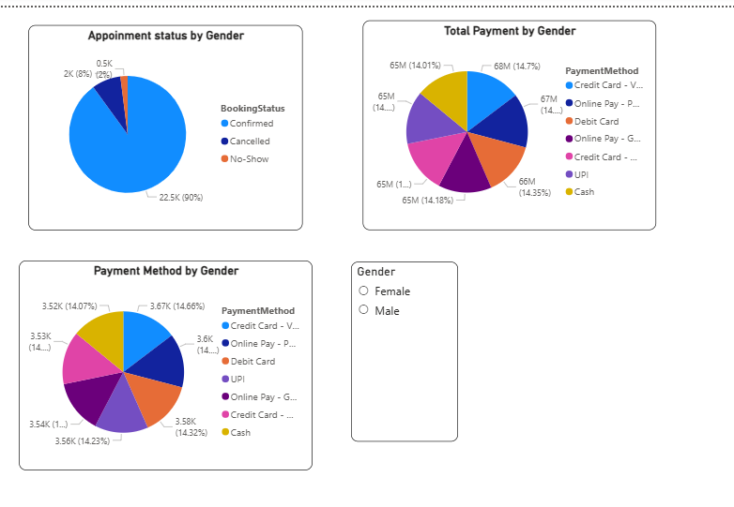
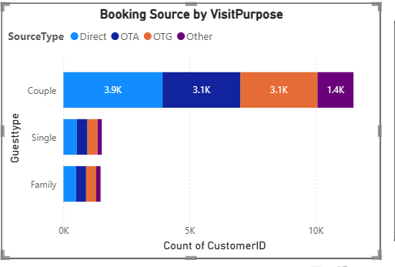
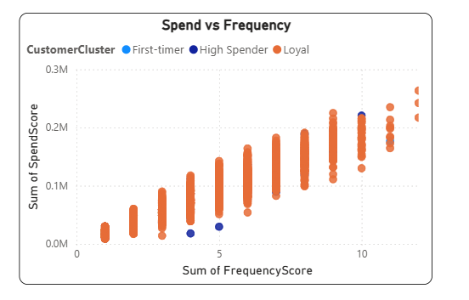
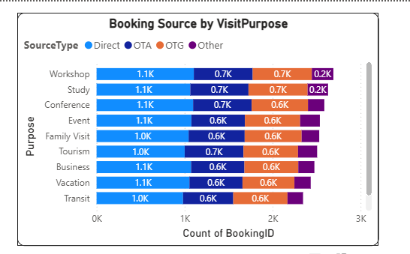
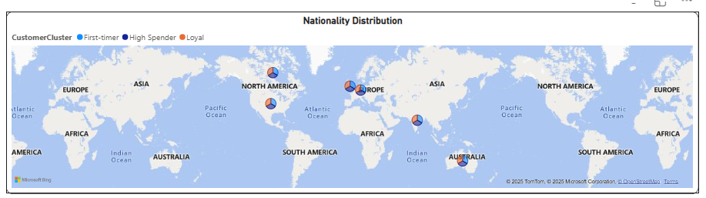
Module 3: Guest Analysis

Slide 11
MODULE 4 : FORECASTING AND CANCELLATION TRENDS
OVERVIEW OF MODULE:
The analysis uses key metrics and visualizations to support proactive revenue management strategies.
KEY INSIGHTS DELIVERED:
Occupancy Forecasting (Future Scope): Predicting future occupancy levels.
Cancellation Rate: Tracking the proportion of canceled bookings.
Lead Time Distribution: Understanding the duration between the booking date and check-in date.
Refund and No-show Behavior: Quantifying lost revenue from refunds and guests who don't arrive.

Slide 12
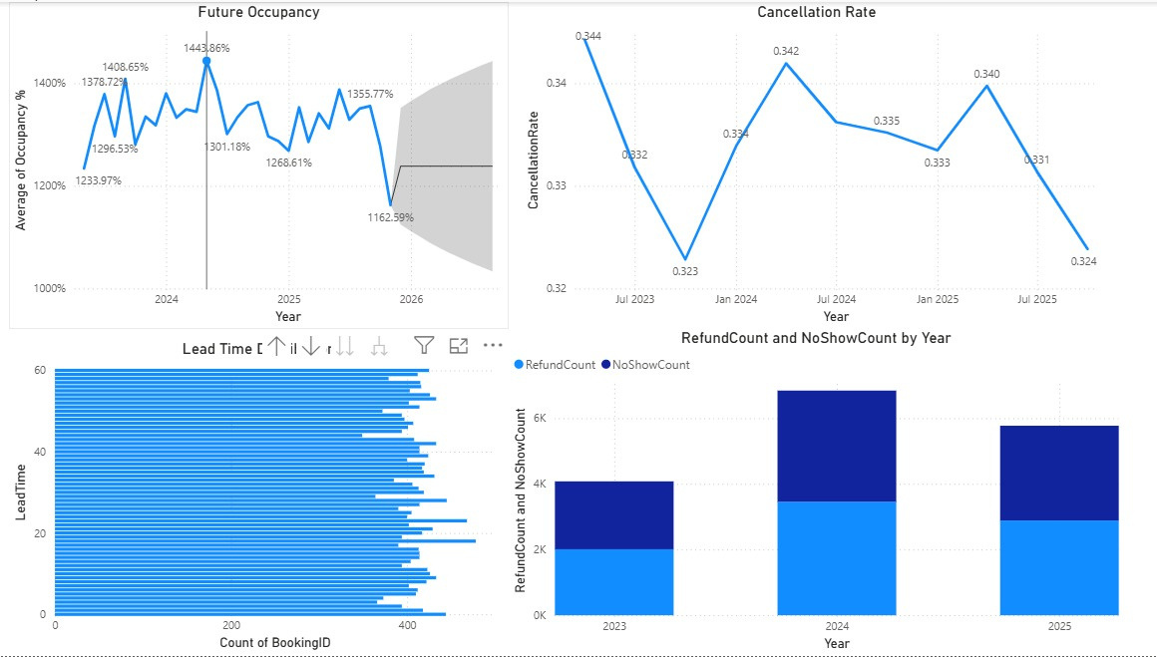
FORECASTING AND CANCELLATION INSIGHT
FUTURE OCCUPANCY:
Highly volatile average occupancy percentage
2026 forecast ranges between 1100% and 1200%
Cancellation Rate:
Moderate fluctuation
Ranges from 0.323 to 0.344
Period: July 2023 to July 2025
Lead Time:
Majority of bookings have a short lead time
Typically between 0 and 60 days
Refund/No Show Trend:
Peaks in 2024
Decreases in 2025

Slide 13
KEY MEASURES & CALCULATIONS USED IN POWER BI
Occupancy % = DIVIDE([Room Booked], [Total Rooms]) * 100
Occupancy %
Cancellation Rate =DIVIDE(COUNTROWS(FILTER(Bookings,
Bookings[CancellationFlag] = "Yes") ),
COUNTROWS(Bookings))
2.Cancellation Rate
3.Lead Time
Lead Time =DATEDIFF(Bookings[BookingDate],Bookings[CheckInDate], DAY)
Refund Count =CALCULATE(COUNTROWS(Bookings),
Bookings[RefundAmount] > 0)
4.Refund Count

Slide 14
Module 5: Revenue Strategy Dashboard
AI-Driven Pricing & Upsell Analytics for Hotels
Key Focus:
Centralised Power BI dashboard for revenue decisions
Combines room pricing and ancillary upsell analytics
Designed for General Managers & Revenue Managers
What Problem It Solves:
Identifies missed upsell opportunities
Optimizes seasonal & room-type pricing
Replaces guesswork with data-backed decisions

Slide 15
Upsell Potential – Ancillary Services
1. Upsell Potential (Ancillary Services)
Analyzes guest spend on spa, dining, services
Identifies high-value & repeat guests
Highlights high-margin but underperforming outlets
2. Pricing Tiers (Seasonal + Room Type)
Peak season → premium pricing
Weekends → mid-tier pricing
Off-season → discounts & bundles
Different pricing logic per room category

Slide 16
Scenario Testing & Business Impact
Interactive Decision-Making
What-If Parameters
Price Uplift %
Occupancy Sensitivity (demand elasticity)
Scenario Demo
Baseline vs adjusted ADR, Occupancy, RevPAR
Real-time KPI updates using sliders
Impact for Managers
Higher ADR & RevPAR
Improved upsell conversions
Faster, confident pricing decisions
Reduced dependency on intuition

Slide 17
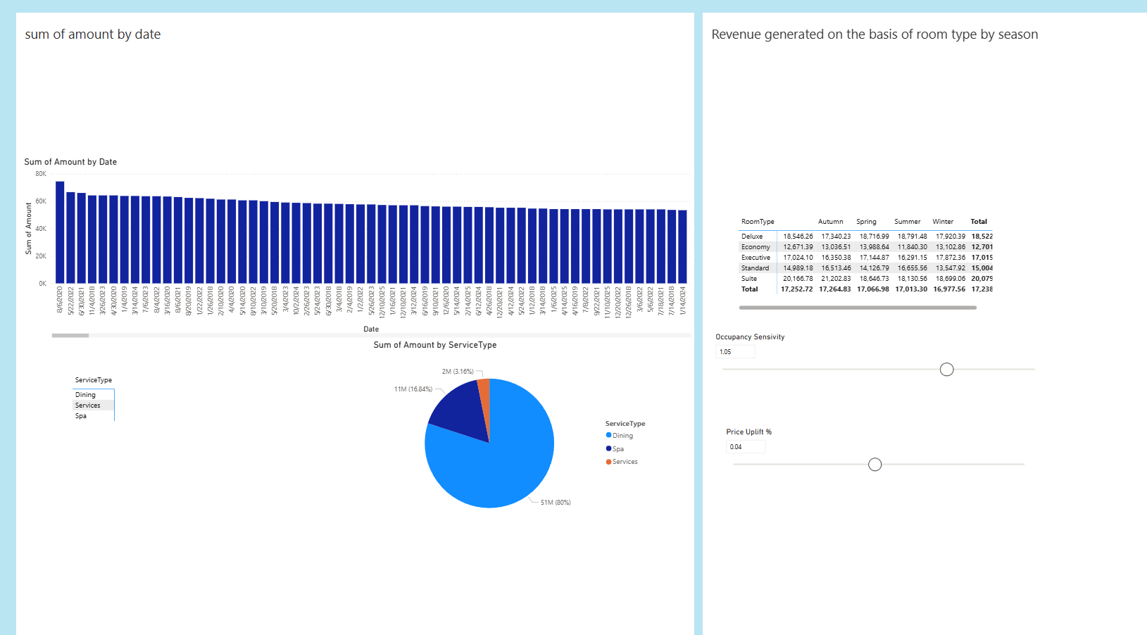
Module 5: Revenue Strategy Dashboard
Price Uplift
Refers to the increase in revenue or average price achieved by raising prices.
Compares to a baseline, such as the previous price, standard rate, or control scenario.
Aims to improve revenue without losing proportional demand.
Measures the effectiveness of pricing changes.
Occupancy Sensitivity
Indicates how occupancy or demand changes in response to a price change.
Demonstrates customer sensitivity to price increases or decreases.
High sensitivity: Small price changes lead to large occupancy changes.
Low sensitivity: Occupancy remains stable despite price changes.

Slide 18
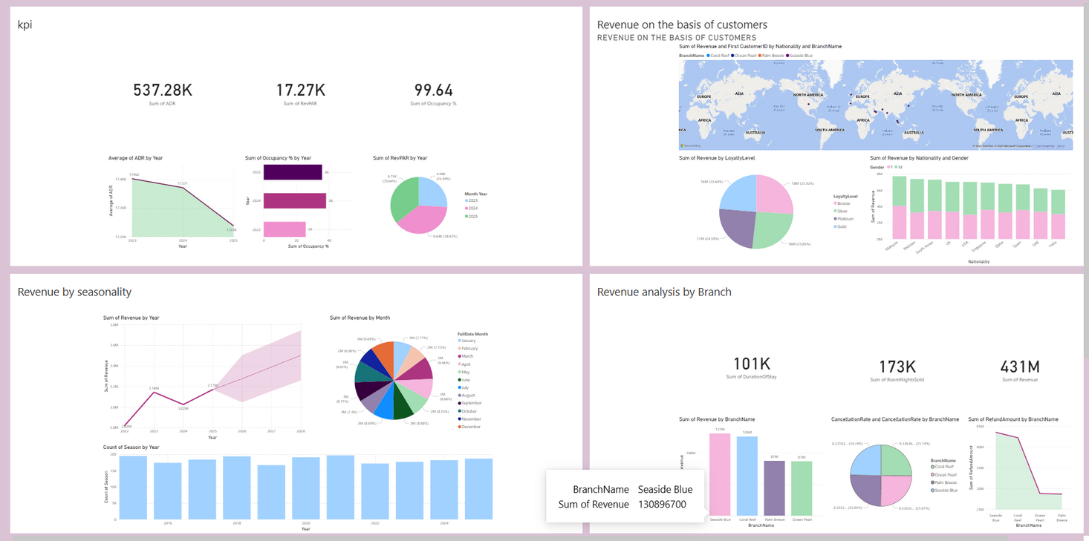
Revenue Manager Dashboard
Stable RevPAR and improving occupancy show effective room use and resilient revenue, despite a slight ADR decline.
Revenue growth is steady, driven by high-value segments like key international markets and loyalty members.
Performance varies across branches; higher cancellations at some locations suggest a need to improve booking policies and customer experience.

Slide 19
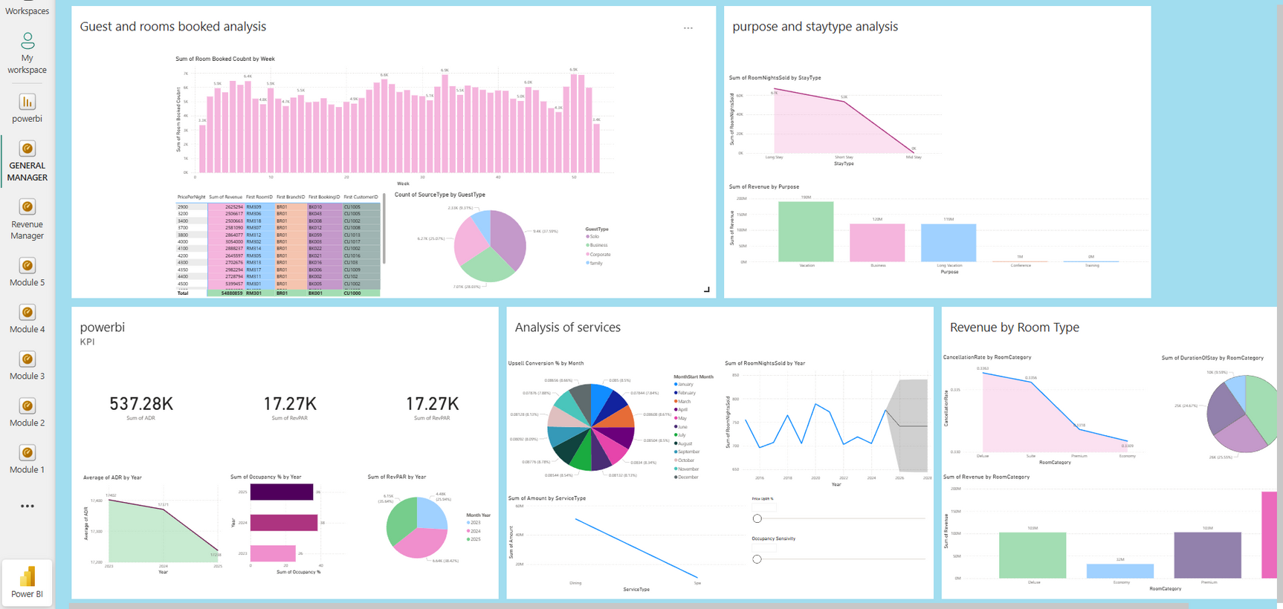
General Manager Dashboard
Bookings are stable week-to-week with seasonal peaks.
Solo and Business travelers are the main drivers of demand.
Long stays and Vacation travel generate the highest value.
Suite and Premium rooms are key revenue drivers.
Economy rooms provide stable occupancy but with low margins.

Slide 20

THANK
YOU

